Slide 1
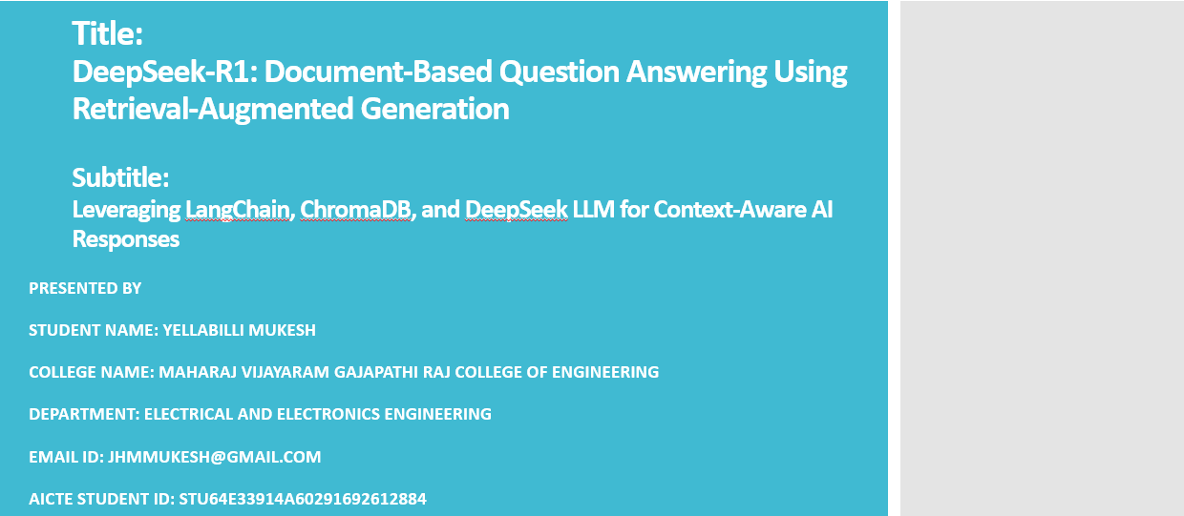

Slide 2
OUTLINE
Problem Statement
Proposed System/Solution
System Development Approach
Algorithm & Deployment
Result
Conclusion
Future Scope
References

Slide 3
Problem Statement
Traditional question-answering systems often struggle to provide accurate answers when the context is not pre-defined or when working with large volumes of unstructured local documents. There is a growing need for systems that can intelligently understand, retrieve, and generate answers from document content uploaded by users.

Slide 4
Proposed Solution
The proposed system aims to simplify and enhance the process of extracting useful information from large documents by enabling users to upload files (e.g., PDFs, TXT) and ask natural language questions. This challenge is addressed using a Retrieval-Augmented Generation (RAG) based approach, combining vector-based search and advanced generative AI to deliver accurate, context-aware answers. The system is designed to efficiently retrieve relevant content using vector embeddings and generate human-like responses through a powerful language model (DeepSeek LLM). The solution consists of the following components:
1. Document Upload and Ingestion
Allow users to upload various document formats through a user-friendly interface.
Accepted file types include PDF, TXT, and other plain-text-supported documents.
Documents are automatically parsed and segmented into manageable text chunks for processing.
2. Text Preprocessing and Embedding
Each document is cleaned, removing noise and irrelevant characters.
Text is divided into coherent chunks to preserve contextual flow.
Each chunk is converted into numerical embeddings using FAISS (Facebook AI Similarity Search). These embeddings help represent semantic meaning for similarity-based retrieval.
3. Vector Storage with ChromaDB
All document embeddings are stored in ChromaDB, a high-performance vector database.
ChromaDB allows fast and efficient similarity searches based on cosine distance or other similarity metrics.
This enables retrieval of the most relevant chunks based on the user’s query.
4. Query Processing and Retrieval
The user submits a natural language query through the interface.
The query is also embedded and compared with stored document vectors to find the top relevant chunks.
These chunks are selected and passed along with the query to the language model.

Slide 5
Proposed Solution
5. Answer Generation using DeepSeek LLM
The retrieved chunks and the original query are fed into the DeepSeek Large Language Model, a generative AI model.
DeepSeek LLM synthesizes the final answer by understanding the context and reasoning over the retrieved information.
This approach ensures that answers are accurate, informative, and context-sensitive, mimicking human-level comprehension.
6. Deployment
The entire pipeline is deployed using Streamlit, enabling a clean and interactive web interface.
Backend operations are handled using Python, with LangChain managing the orchestration between document handling, retrieval, and LLM communication.
The system is scalable and can be hosted on cloud platforms for real-time use.
7. Evaluation
The system is evaluated based on response relevance, contextual accuracy, and user satisfaction.
Manual and automated testing is used to compare generated answers with expected document content.
Continuous feedback is incorporated to fine-tune chunk size, embedding quality, and model behavior for improved performance.
Result
The system allows seamless document uploads and accurate, real-time question answering.
It drastically reduces the time required for document review and information retrieval.
Users receive concise, context-aware responses, making the system useful for legal, academic, technical, and research documents.

Slide 6
System Approach
1. System Requirements:
Operating System: Windows/Linux/Mac
Python version: 3.8 or above
Hardware: Minimum 8 GB RAM, recommended 16 GB+ for faster processing
Storage: SSD with sufficient space for storing document embeddings and logs
Internet: Required for model access (if using hosted LLMs)
2. Required Libraries and Tools:
LangChain – for orchestrating document loading, embedding, and retrieval
ChromaDB – vector store for storing and querying text embeddings
FAISS – for fast and efficient similarity search
DeepSeek LLM – for generating context-aware answers
Streamlit – for creating a user-friendly web interface
PyMuPDF / pdfminer.six / Textract – for PDF and text file parsing
Transformers & SentenceTransformers – for embedding generation and model interaction
OpenAI / Hugging Face APIs (if using external LLMs)

Slide 7
Algorithm & Deployment
Document Upload: Users upload one or more documents via Streamlit.
Text Splitting & Embedding: Documents are split into chunks; each chunk is converted into a vector using FAISS.
Storage: ChromaDB stores these vectors for fast similarity-based retrieval.
Query Processing: LangChain processes user queries and retrieves the most relevant chunks.
LLM Response: DeepSeek LLM generates the final answer based on the retrieved content.
Deployment: Hosted as a web app for real-time usage via Streamlit.

Slide 8
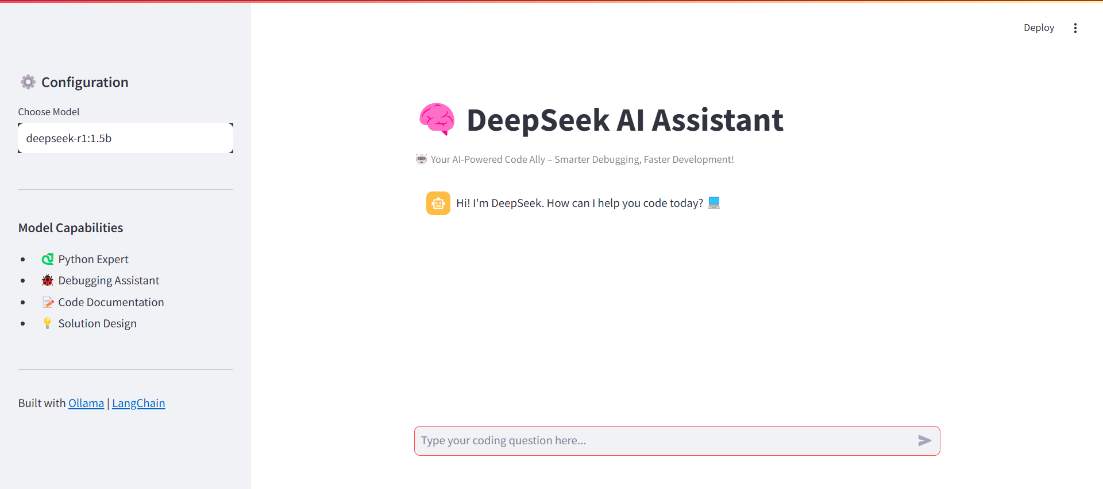
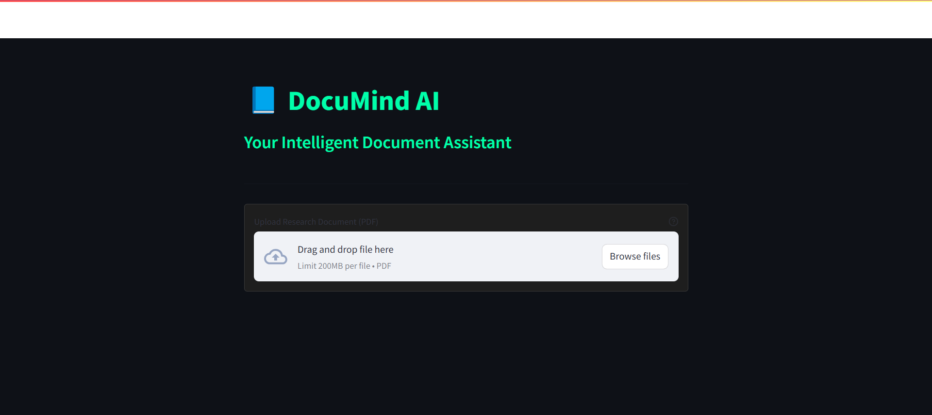
Result

Slide 9
Conclusion
The DeepSeek-R1 system successfully demonstrates how RAG pipelines can be used for intelligent document-based Q&A. It enhances user experience by replacing traditional keyword-based search with context-rich responses. The system is modular, scalable, and capable of adapting to various document types and domains.

Slide 10
Future scope
Integrate additional LLMs for comparison (e.g., GPT-4, Claude)
Add support for multiple file formats including images and scanned documents (OCR)
Enhance performance with GPU-based inference
Add feedback and learning loop for improving future responses
Develop an API for enterprise integration

Slide 11
References
LangChain Documentation: https://docs.langchain.com
ChromaDB: https://www.trychroma.com
FAISS by Facebook AI: https://github.com/facebookresearch/faiss
DeepSeek LLM: https://github.com/deepseek-ai
Streamlit: https://streamlit.io
My Github Link: https://github.com/mukeshyellabilli/deepseek-r1.git

Slide 12
Thank you

